Slide 1
Heatmap, Pairplot, Jointplot
29-Aug-2023

Slide 2
glue = sns.load_dataset("glue").pivot("Model", "Task", "Score")
sns.heatmap(glue)
Use annot to represent the cell values with text:
sns.heatmap(glue, annot=True)
Control the annotations with a formatting string:
sns.heatmap(glue, annot=True, fmt=".1f")
References on dataset:
https://seaborn.pydata.org/generated/seaborn.heatmap.html
Heatmap

Slide 3
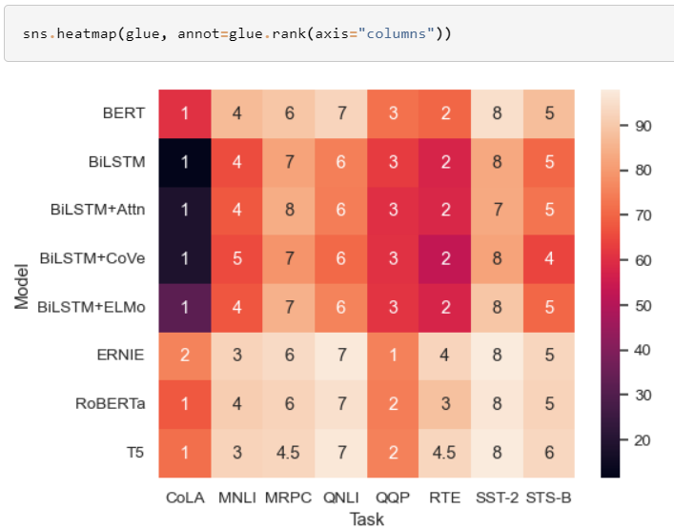
Use a separate dataframe for the annotations:
sns.heatmap(glue, annot=glue.rank(axis="columns"))
Heatmap

Slide 4
A pair plot is a data visualization that plots pair-wise relationships between all the variables of a dataset.
This allows you to better understand the relationships visually
penguins = sns.load_dataset("penguins")
sns.pairplot(penguins)
Assigning a hue variable adds a semantic mapping and changes the default marginal plot to a layered kernel density estimate (KDE)
sns.pairplot(penguins, hue="species")
Pair plot

Slide 5
It’s possible to force marginal histograms:
sns.pairplot(penguins, hue="species", diag_kind="hist")
The markers parameter applies a style mapping on the off-diagonal axes.
sns.pairplot(penguins, hue="species", markers=["o", "s", "D"])
Set corner=True to plot only the lower triangle:
sns.pairplot(penguins, corner=True)
References:
https://seaborn.pydata.org/generated/seaborn.pairplot.html
Pair plot

Slide 6
Draw a plot of two variables with bivariate and univariate graphs.
In the simplest invocation, assign x and y to create a scatterplot (using scatterplot()) with marginal histograms (using histplot()):
penguins = sns.load_dataset("penguins")
sns.jointplot(data=penguins, x="bill_length_mm", y="bill_depth_mm")
Set kind="reg" to add a linear regression fit (using regplot()) and univariate KDE curves:
sns.jointplot(data=penguins, x="bill_length_mm", y="bill_depth_mm", kind="reg")
Joint plot

Slide 7
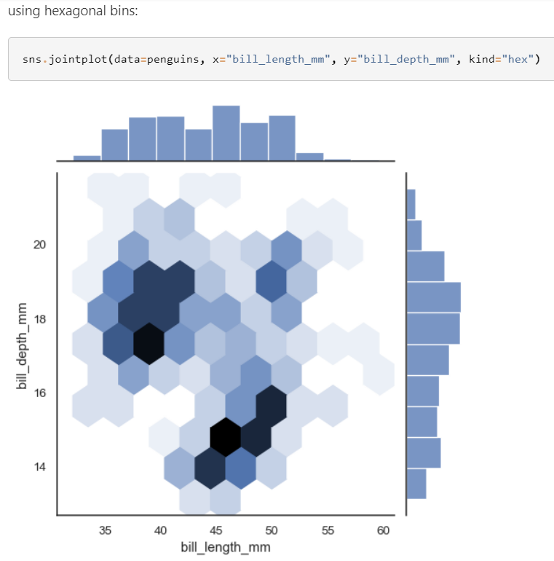
sns.jointplot(data=penguins, x="bill_length_mm", y="bill_depth_mm", kind="hex")
References:
https://seaborn.pydata.org/generated/seaborn.jointplot.html
Joint plot

